Slide 1
OpenClassrooms - Salesforce Developer path
Presentation
Project 1: Spend a day in the life of a Salesforce Consultant
Thabit Hamror
29.12.2021
Brussels

Slide 2
Project presentation dates
(least optimistic scenario)

Slide 3
Sources of news and info

Slide 4
Clouds and features of Salesforce
As CRM, Salesforce allows you to track and manage customer information. As a collaboration tool it allows you to connect your team's work and processes. As an analytical module it gives you insight and recommendations on how to improve your sales. Most importantly, as a single hub, it allows you to connect all these applications and more together in one place.
Salesforce is made up of clouds, otherwise known as modules or services. Each of these clouds consists of certain features (or tools).
In addition to the Community cloud, we can say that Salesforce has 3 main clouds, and each cloud has a set of features:
First, the sales cloud and it includes many features such as contact management, lead management, opportunity management...etc. Second, the service cloud which includes the Lightening console, and tools like case management, knowledge base, telephony integration etc. Third, the marketing cloud which has features of email marketing, mobile messaging, social media marketing...etc.

Slide 5
Some native features and their objects
Contact management
(Contact, Lead)
Opportunity management
(Account, Contact, Opportunity)
Lead management
(Lead)
Case management
(Case, CaseRelatedIssue)

Slide 6
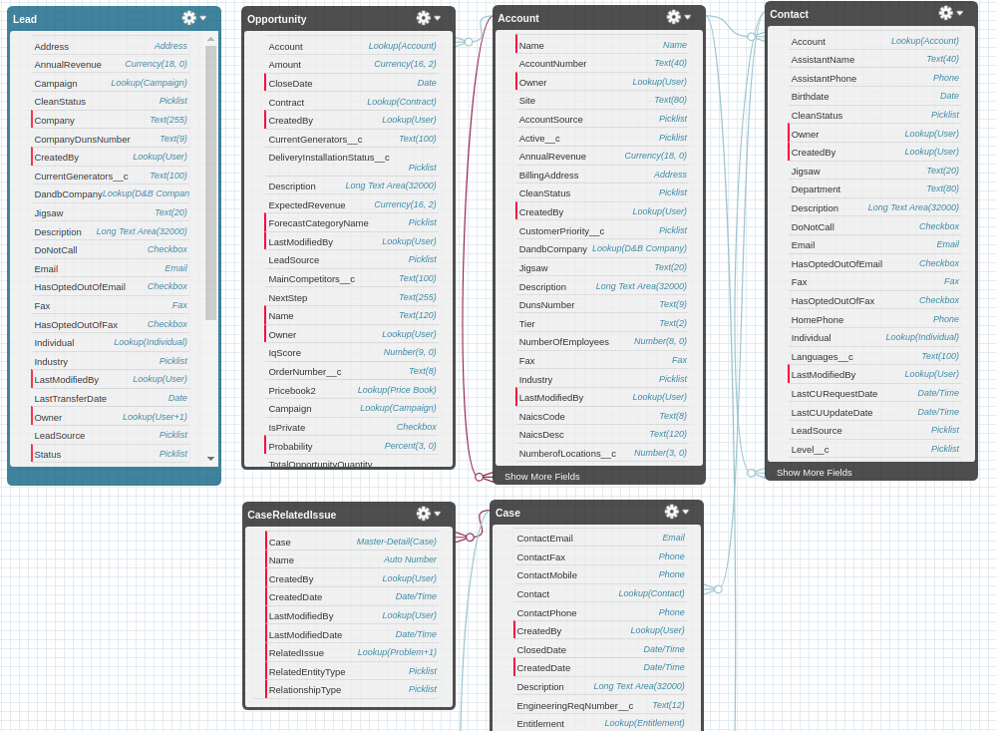
Schema

Slide 7
The job offer: Salesforce based project manager
Industry:
Tech and developer outsourcing
Tasks:
Salesforce org operation; remote dev team management; CRM; define project scope; Identify business specifications; coordination of internal testing; monitoring post launch installations (where applicable)
Skills:
Salesforce certification, project management, Java, Github

